Slide 1

GIT GROUP ASSIGNMENT
GROUP 11
AMAN VERMA
UTKARSH UPADHYAY
SAGAR GOEL
SHIVAM GUPTA
SONU KUMAR
Topic - Cherry-Picking

Slide 2

Cherry-Picking Command
Cherry picking command is used to pick any git commit by using reference and append it to the working directory.
Basic Syntax -
git cherry-pick <commit-reference>

Slide 3
Why Cherry-Pick ?
It can help in applying changes committed in wrong branch accidently.
Apply some changes from other branch to your branch.
If merge is not possible due to incompatible versions of the branches.

Slide 4
Steps for git cherry-pick
git checkout <branch name from which we have to pick commit from>.
git log - To get the commit reference of the commit you have to pick.
git checkout <branch name to which commit has to be applied>.
git cherry-pick <commit reference>.

Slide 5
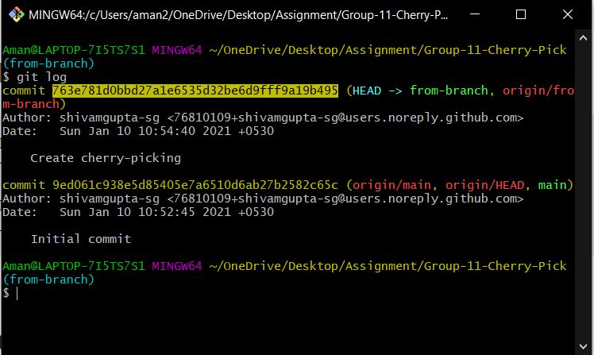
Getting the reference of commit
We can get the reference for commit by using git log command

Slide 6
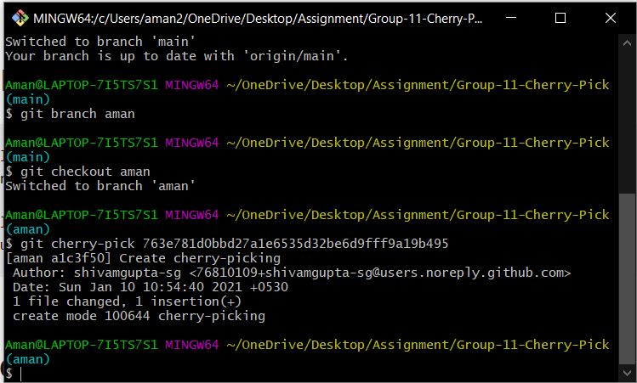
Example for cherry-pick

Slide 7
Other options in cherry-pick command
-n or --no-commit : Brings the changes of the commit to the staged area of current branch but no commit it.
-e or --edit : Lets you edit the commit message prior to commit.
-x : Appends a line “(cherry picked from commit …​)”to the original commit message, indicating from where commit is picked from. Only for the commits cherry-picked from public branch.

Slide 8
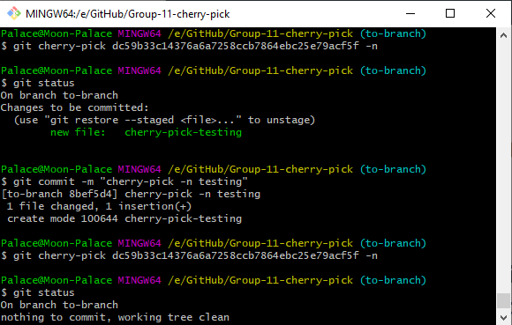
-n or --no-commit

Slide 9
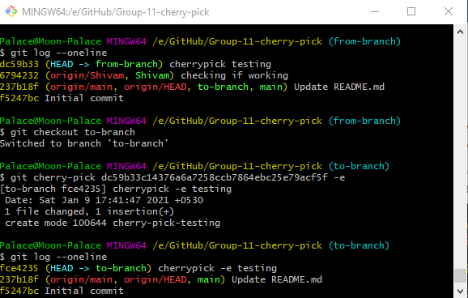
-e or --edit

Slide 10
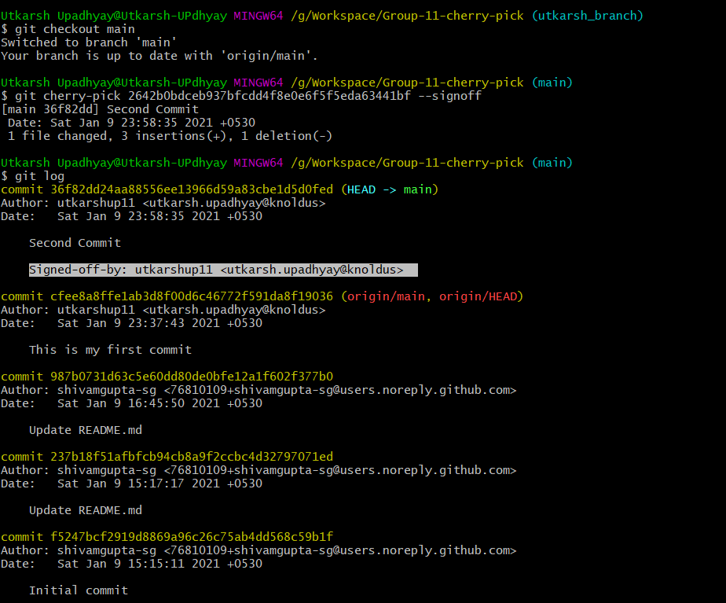
Git cherry-pick <code> --signoff
The “git cherry-pick <code> --signoff “ command just add a line of signature of the person who make the changes after the commit message . (as shown in screenshot attached ) .

Slide 11
Some Usage Of Cherry-Pick
We can avoid useless conflicts by using git cherry-pick instead of other options.
It is used to access the changes introduced to a sub-branch, without changing the branch.
Most of the time we use cherry-pick to restore the commits which we lost .
Sometimes for undoing the changes made we have to apply cherry-pick.

Slide 12
Link for the Group Repository
shivamgupta-sg/Group-11-Cherry-Pick: Git Group Assignment - Group 11 (github.com)

